Slide 1
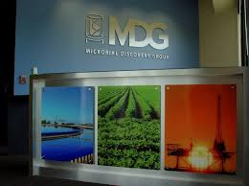
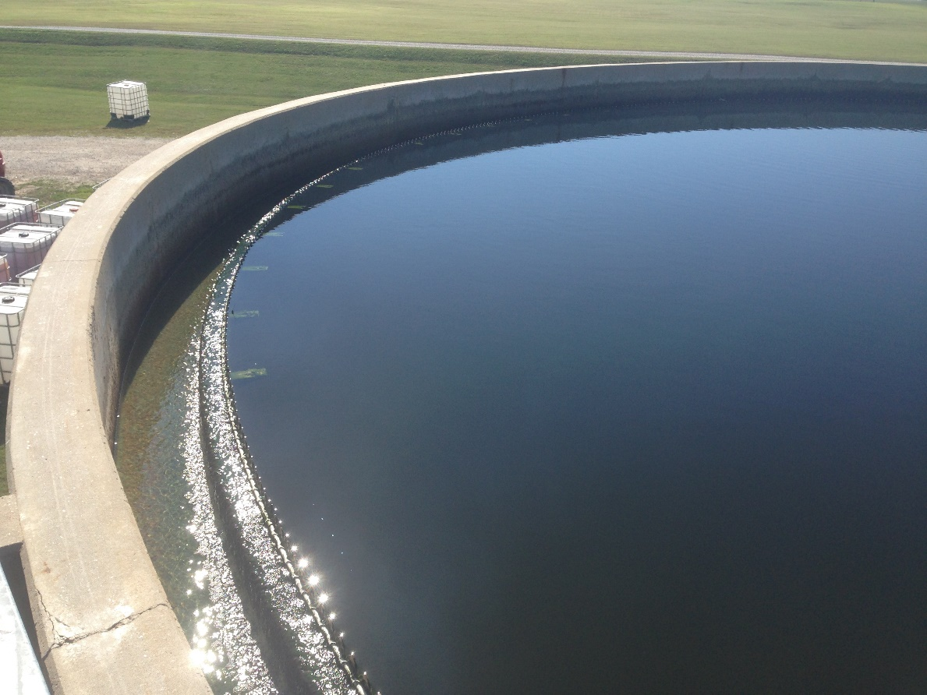
Reference Wastewater Guide

Slide 2
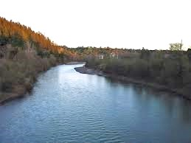
What is wastewater? Domestically, wastewater is generated from bathing, dishwashing, and of course, when we flush the toilet. Wastewater can also be produced through industrial processes such as pulp and paper plants, dairies, cheese, and food manufacturing facilities, as well as textile, pharmaceutical, beverage making, and additional sources.
Why do we need to treat wastewater? To protective the environment and public health, pollutants need to be removed from the wastewater.. If left untreated, these pollutants may negatively affect our water and environment. As an example, organic matter will be broken down by bacteria in the environment, and this can cause a decrease in oxygen in the receiving water bodies. This biological decomposition of organics may result in foul odors as well as cause harm to aquatic life. Nutrients, such as phosphorus can cause Eutrophication, or premature aging of our lakes and water bodies. In wastewater treatment we also eliminate pathogens which can risk public health.

Slide 3
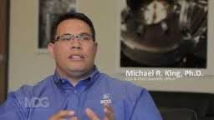
“Our mission at MDG in the wastewater segment is to provide solutions through real science, trusted process, and proven success”
Common Wastewater Abbreviations
AOB: Ammonia oxidizing bacteria. These are bacteria that perform the nitrification process creating nitrate
BOD: Biological Oxygen Demand. A test (typically 5 days) that measures the strength of wastewater based on biological degradation
COD: Chemical Oxygen Demand: A test that measures the strength of wastewater through chemical oxidation.
DO: Dissolved Oxygen
ORP: Oxidation Reduction Potential: The measurement of the oxidation potential in the wastewater expressed as mV. Negative ORP can be thought of as negative DO
SV30: The volume that sludge settles to after 30 minutes
SVI: Sludge Volume Index, a measure of sludge quality
Q: Common abbreviation for flow rate
MLSS: Mixed Liquor Suspended Solids
F/M Ratio: The amount of food to microorganisms present
WAS: Waste Activated Sludge
RAS: Return Activated Sludge
MGD: Millions of gallons per day
GPM: Gallons per minute

Slide 4
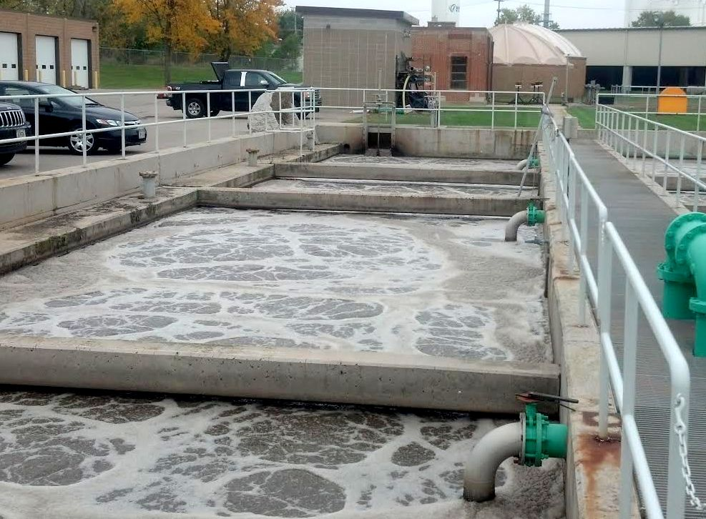
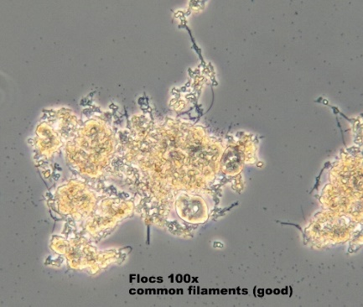
Principles of Activated Sludge
Activated Sludge is the most common form of wastewater treatment systems. There are many variations of activated sludge, but the same basic principles apply. There is an area where treatment occurs, and there is an area where solids are separated from the water and the water is discharged. Settled solids are returned to the head of the aeration tank for another round of treatment. A certain amount of microorganisms are wasted from the process each day to maintain the proper amount of food to microorganisms. The goal is to stabilize organic material (pollution) to levels that are acceptable to the receiving water body. In the aeration tank, dissolved oxygen is provided, and under the proper operating conditions, the bacteria will flocculate (clump together) and settle well in the final clarifiers. A good quality sludge will generally produce a good quality effluent.
Good Floc

Slide 5
Environmental Factors for Activated Sludge
Parameter | Range
Food | Proper amount of food to microorganisms
Hydraulic Flow Rate | Within plant design capacity. Excessive flows can result in suspended solids washout
Oxygen | Many of the bacteria in wastewater require between 1 mg/L to 3 mg/L or more of dissolved oxygen
Temperature | Most microorganisms in wastewater grow best between 10 and 25 degrees C. At >35 to 40 degrees C, thermophilic bacteria will take over
Nutrients | Conventionally a BOD: Nitrogen: Phosphorus ratio of 100:5:1 is recommended in addition to proper micronutrients such as iron and other trace minerals
pH | Between 6.5-8.5 is recommended
Alkalinity | There needs to be enough buffering capacity to maintain the pH. Typically 60 mg/L or more alkalinity at the end of treatment is desired

Slide 6
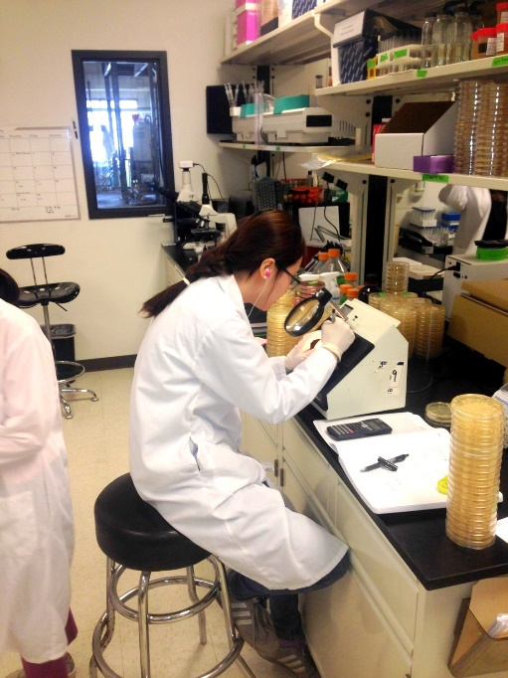
Common Formulas for Wastewater Treatment
Organic Loading Rate: mg/L BOD (or COD) x flow, as MGD (millions of gallons per day) x 8.34
F/M Ratio: Lbs BOD per day/ lbs MLSS (mixed liquor suspended solids)
Retention time (hours): tank volume x 24 hours/ flow
Sludge Age (days): lbs MLSS or MLVSS in system inventory/ lbs of suspended solids leaving the plant per day via wasting or as suspended solids in the effluent.
Removal percentage: This can be used to determine treatment rates for various parameters: lbs removed/ lbs in influent x 100
Philosophy at Microbial Discovery Group
We are heavily involved in research and development and are becoming a world leader in finding innovative solutions to wastewater treatment issues. We have highly trained technical staff available to provide assistance. Our goals are to meet your needs as well as to instill competence and confidence through our training programs and our dedication to cleaning, and protecting the environment.

Slide 7
Wastewater: Common Terminology
Activated Sludge: An aerobic biological wastewater process in which the decomposition of wastes is accelerated by providing a higher concentration of microorganisms than normally found in nature. With proper growth parameters for the bacteria, the organic waste can be treated and a good quality sludge produced that settles well in the final clarifiers.
Aeration Basin: Area where microorganisms and organic waste mix in the presence of oxygen for wastewater treatment to occur
Absorption: when a microorganism takes in a substance
Adsorption: The process in which a substance collects on the surface of another substance. (Particulate food or BOD is adsorbed, and further broken down for absorption through the cell membrane of the bacteria
Aerobic Digester: An area where sludge is stabilized through reduction of volatile suspended solids based on endogenous activity. Waste Activated Sludge is often sent here before ultimate disposal to reduce volume of sludge to be hauled as well as meet potential disposal parameters
Aerobic Reaction: Occurs in the presence of oxygen using oxygen as the electron receptor
Aerobic Selector: Small aerated compartmentalized area in which there is a very high amount of organic matter (food) to microorganisms. The intent of an aerobic selector is to select floc forming bacteria to grow in the treatment process

Slide 8
Algae: Microscopic plants that contain chlorophyll and live in water or may be attached to submerged surfaces. They produce oxygen during the day and use oxygen in the night time.
Ammonia: A compound of nitrogen and hydrogen. (NH3). This is the form available to bacteria as a nutrient (although nitrate can also be taken up as a source of nitrogen by some bacteria)
Ammonium: The positively charged ion formed by the protonation of ammonia. The equilibrium between ammonium and ammonia depends on pH. At higher pH, more ammonia is present. Note: It is common for probes to report ammonium + ammonia as simply ammonia.
Anoxic: A condition in which free oxygen is not present, but combined oxygen is found in compounds such as nitrate and sulfate.
Anoxic Selector: A compartmentalized area in which a high amount of food to microorganisms and anoxic conditions are desired. Denitrification occurs in these stages and a common purpose and anoxic selectors are often used to outcompete certain filamentous bacteria.
Anaerobic: A condition in which no free oxygen is available
Anaerobic Selector: A small compartmentalized area free of any oxygen (including combined oxygen forms) at the head of treatment designed for a high amount of food to microorganisms. These may be found in enhanced biological phosphorus removal processes. Certain bacteria store food under anaerobic conditions and this gives them a competitive advantage over other bacteria in the aeration basin.

Slide 9
Alkalinity: The capacity of water or wastewater to neutralize acids expressed in mg/L of equivalent calcium carbonate.
Aerated Stabilization Basin: A lagoon-type wastewater system with added oxygen that is often found in industrial wastewater systems such as paper mills. These are similar to wastewater treatment lagoons. They are advantageous for paper mills because of nutrient recycling from the benthic (bottom) sludge layer to reduce necessary nutrient addition in these systems.
Aerated Lagoon: A wastewater treatment process in which added aeration is used. There is an aerobic layer above the benthic (bottom) layer of sludge. These systems are common in rural areas and where there is a large footprint
Bacillus: A family of gram positive, rod shaped bacteria with spore forming capability that are known for the large range of enzymes they produce.
Bio-flocculation: The clumping together of fine and dissolved organic particles by the action of certain bacteria resulting in fast and complete settling of organic solids. Strong flocs are desired in wastewater treatment processes for their settling characteristics. A good quality sludge produces a good quality effluent.
BOD (Biological Oxygen Demand): A test ran to measure the strength of wastewater or the degree of pollution. Commonly this is a 5 day test in which the sample is stored at 20 degrees C for 5 days and the amount of oxygen depleted by the bacteria is measured in mg/L.
Bio-degradeable: Waste that can be broken down (treated) in a reasonable amount of time by microorganisms.

Slide 10
Bulking: A condition in which sludge compacts poorly. The definition of a bulking sludge is a sludge having an SVI (sludge volume index) of >150. Ultimate the definition of a bulking sludge is an SVI range in which sludge compaction is poor and due to high sludge blankets in the final clarifiers, sludge is lost to the effluent. Bulking is the number one cause of wastewater violations. Bulking sludges can filamentous in nature or due to excessive polysaccharide (slime bulking) and may be caused by low dissolved oxygen, septicity (organic acids and sulfide), low food to microorganism ratio (low F/M), low pH, and nutrient deficiency.
Biological Nutrient Removal (BNR): A process that is used for nitrogen and phosphorus removal in wastewater systems
Buffering Capacity: The measure of the ability of a liquor to neutralize bases or acids and resistance to change in pH.
Biosolids: Wastewater sludge. Biosolids is an emerging term for this as it is more positive sounding name. Biosolids are often land applied once they are treated to a stable form.
Case Study: A report of a trial period in which certain parameters were measured or adjusted with the intention to achieve what is defined as success.
Composite Sample: A sample that is composed of a collection of individual samples taken at regulated intervals. It is common that composite samples are flow proportional, although in some cases, they can be taken on the basis of time (example: Sample is taken every 30 minutes).

Slide 11
Clarifier: A tank where wastewater is held for a period of time in which heavier solids settle to the bottom. Primary clarifiers are commonly used in wastewater for primary treatment. Final clarifiers separate the treated (clear) water with the mixed liquor which is then returned to the aeration basin or wasted from the process.
Coagulant: A chemical that causes fine particles to form larger particles. Coagulation is desired in sludge dewatering and often in liquid/ solids separation
Coliform: A type of bacteria that indicates the possible presence of pathogenic bacteria. Coliform bacteria are often tested for as they are easier to identify than pathogens and compete in the same environments.
Colloidal: Solids that are not dissolved, but do not settle rapidly
Chemical Oxygen Demand (COD): A measure of the strength of wastewater expressed as the amount of oxygen consumed from a chemical oxidant. The chemical used in this test may react with material that bacteria will not so COD is always greater than BOD (biological oxygen demand).
DO (dissolved oxygen): atmospheric oxygen dissolved into water.
Denitrification: An anoxic process in which nitrate is converted to nitrogen gas. For denitrification to occur the following are needed 1) no free dissolved oxygen 2) the presence of nitrate 3) a carbon source (soluble BOD). Denitrification (floating sludge) is a common problem in secondary clarifiers of wastewater plants. Avoiding this involves removing one of its three ingredients.

Slide 12
Dispersed Growth: A condition in which bacteria do not flocculate together. Causes for this include high cellular growth rates (high F/M), the presence of surfactants or toxicants, temperature fluctuation, and a high ratio of monovalent to divalent or multivalent ions in wastewater (i.e. high amounts of potassium and sodium in relations to calcium and magnesium).
Degradation: The breaking down of one substance into simpler substances. An example would be that in wastewater treatment bacteria break down organic matter (BOD) into end products of carbon dioxide and water.
Detention time (also known as retention time): The time water remains in a certain area (tank, treatment plant etc).
Digester: A tank in which sludge is placed for decomposition and reduction of volatile suspended solids. These can be anaerobic or aerobic processes.
Disinfection: A process that is designed to kill or inactivate specific microorganisms. Chlorination and UV disinfection are the two main ways that pathogens are killed in wastewater. Chlorine is also occasionally used to selectively kill filamentous bacteria.
Effluent: Wastewater or another liquid exiting an area (i.e. tank, system, lagoon etc)
Endogenous Respiration: A condition in which organisms use their own cellular material instead of new organic matter to sustain themselves.
Enzymes: Organic substances which are produced by living organisms that cause or speed up chemical or biochemical reactions

Slide 13
Equalization basin: A holding area or tank where water is collected before treatment. These basins help to reduce variations of flow and chemical composition in the incoming wastewater
Enhanced Biological Phosphorus Removal (EBPR): A process involving an anaerobic selector, in which certain organisms are selected that ultimately achieve higher phosphorus uptake than conventional wastewater bacteria
Excocellular material: polysaccharide, “slime”, or “bug glue”. This material helps the flocs stick together. Under certain conditions bacteria can produce too much “slime” and this can create problems.
Food/Microorganism Ratio (F/M ratio): A measure of the amount of food provided to the bacteria using the organic loading rate in lbs/day BOD/ the lbs of MLVSS (mixed liquor volatile suspended solids) in the system
Facultative bacteria: These bacteria possess the enzymes to use free dissolved oxygen or oxygen that is combined in materials such as sulfate or nitrate. They can live in anaerobic, anoxic, or aerobic environments.
Filamentous Organism: Organism that grow in a thread-like or filamentous form. A “common” abundance of these organisms are beneficial to serve as a backbone for flocs, but and at greater abundance filamentous bacteria can cause settling and dewatering problems
Floc: Clumps of bacteria and other material that adhere together and form a cluster. Strong flocs are beneficial for good settling, dewatering, and biological treatment. If the right growth parameters are involved, strong floc formation should occur.

Slide 14
Grab Sample: A single sample collected at a single period of time and represents the characteristics of the water at that given time.
Hydrogen Sulfide: A gas with a rotten-egg like odor produced when sulfate is broken down in anaerobic conditions. This gas is highly toxic, corrosive, and dangerous. Some filamentous bacteria are able to utilize hydrogen sulfide for growth.
Heterotroph: Organisms that break down organic matter as food
India Ink stain: a staining procedure used in wastewater microscopy to view the abundance of slime-lik exocellular material (polysaccharide).
Influent: Wastewater or liquid entering a specific area such as a treatment plant, tank, clarifier etc.
Inhibitory substance: A material that is kills microorganisms or slows down their ability to degrade waste
Inorganic: Material such as sand, salt, and other minerals which cannot be further degraded by bacteria
MCRT (Mean Cell Residence Time): The amount of time in days that a microorganism will spend in the activated sludge process: Total lbs or kg of suspended solids in system/ Total lbs or kg suspended solids leaving system/day
Media: Material on a fixed film process in which microorganism attach to and grow. Media may be found in processes such as trickling filters, rotating biological contractors, or processes such as MBBR (moving bed bio reactor).

Slide 15
Mesophilic temperature range: Between 68 degrees F (20 degrees C) and 113 degrees F (45 degrees C). Most bacteria in wastewater process will enter the thermophilic temperature range shortly after 100 degrees F.
Mixed Liquor: Activated sludge in the aeration tank mixed with raw wastewater or wastewater after primary treatment.
Mixed Liquor Suspended Solids (MLSS): Suspended solids within the mixed liquor. This is used in many process control calculations.
Mixed Liquor Volatile Suspended Solids (MLVSS): Organic or volatile portion of the MLSS. This more closely represents the portion of active bacteria than mixed liquor suspended solids.
Nitrification: The process in which aerobic bacteria change ammonia to nitrite and then nitrate
Nutrients: Substances that are needed for microorganisms to grow. Nitrogen and Phosphorus are the most critical macronutrients needed in activated sludge. Iron and micronutrients are also needed for growth.
Organic Waste: Waste material mainly from plant or animals that can be consumed by bacteria and other small microorganisms
Oxidation Reduction Potential (ORP): The electric potential measured in millivolts required to transfer electrons from one compound to another. As material is more oxidized the ORP will increase. Negative ORP values can be thought of as negative dissolved oxygen
Organic Acid: An organic compound with acidic properties. These can be formed in areas of septicity where bacteria come into contact with organic matter in the absence of oxygen

Slide 16
Pathogen: Organism which can cause disease. These organisms are commonly treated through disinfection in wastewater
Photosynthesis: A process in which organisms that use chlorophyll, convert carbon dioxide and inorganic substances into oxygen and new plant material in the presence of sunlight.
Polymer: A long chain molecule that is formed by many molecules of lower molecular weight. Polymers are often used as settling aids in wastewater and for sludge dewatering
Potable: Water that meets criteria of being safe for drinking
Preliminary Treatment: Removal of larger materials such as rags, rocks, and sands before further wastewater treatment
Primary Treatment: A process that does not rely on biological activity where suspended material is removed through settling or skimming off the top of the basin
Raw Wastewater: A term for wastewater that has not received any forms of treatment
Respiration: The process in which an organism uses oxygen and releases carbon dioxide. Respirometry and oxygen uptake rates are common tools used for troubleshooting wastewater processes.
Retention time: The time that a material is held in a certain area
SVI (Sludge Volume Index): A calculation used to determine the quality and settling characteristics of a sludge. Typically this is test conducted in a 1000 mL container (settlometer) in which the volume that the sludge settles to within 30 minutes is recorded. SVI, mL/gm= Volume to which sludge settles/ concentration. Generally, an SVI in the range of 50-150 mL/gm of MLSS is considered good.

Slide 17
Septicity: A condition in which organic matter is fermented in the absence of free oxygen. This can give off odors and create a black color to the wastewater.
Short-Circuiting: A condition in which there is not a uniform flow of water through a tank or basin
Sludge age: The measure of length in time a microbe remains in the activated sludge process. (Similar to MCRT and Sludge Retention Time). Suspended solids under aeration in lbs or kg/ suspended solids leaving the system (wasted sludge of suspended solids in the effluent) per day
Stabilize: To convert to a form that resists change. In wastewater this would be treating the waste to the extent that its rate of decomposition would not be a problem to the receiving waters.
Synthesis: When two or more substances combine to form a new substance
Step-Feed: To feed incoming wastewater at multiple parts of the aeration tank as opposed to plug flow, in which wastewater enters from one end and leaves the other end
Struvite: A deposit of magnesium ammonia phosphate hexahydrate. Struvite can be formed in digested sludge lines and valves where these materials are present and create plugging issues. Struvite can also be encouraged in desired processes as a form of phosphorous removal through struvite recovery.
Supernatant: The liquid above a settled sludge
TOC (Total Organic Carbon): A measurement of the strength of water through the total amount of carbon present

Slide 18
Toxic: A poisonous substance that can kill microorganisms
Volatile Acids: Fatty Acids that are produced during anaerobic activity. These may also be referred to as organic acids or VFAs (volatile fatty acids).
Weir: A wall or plate placed in an open channel used to measure the flow of water or used to ensure a uniform flow rate
WAS (Waste Activated Sludge): Sludge that is removed from the activated sludge process to maintain the desired amount of food to microorganisms
Zooglea: A floc forming bacteria that grows on organic acids and certain alcohols present in the wastewater. At high abundance, zooglea bacteria can cause settling and dewatering problems in wastewater due to their thick slime capsules

